Slide 1
Instructor Materials Chapter 8: Applied Networking
IT Essentials v6.0
Notes:
Cisco Networking Academy Program
IT Essentials
Chapter 8: Applied Networking

Slide 2
Instructor Materials - Chapter 8 Planning Guide
This PowerPoint is divided in two parts:
Instructor Planning Guide
Information to help you become familiar with the chapter
Teaching aids
Instructor Class Presentation
Optional slides that you can use in the classroom
Begins on slide #11
Note: Remove the Planning Guide from this presentation before sharing with anyone.
Notes:
2

Slide 3
ITE 6.0 Planning Guide
Chapter 8: Applied Networking
Notes:
ITE 6.0 Planning Guide
Chapter 8: Applied Networking

Slide 4
Chapter 8: Activities
What activities are associated with this chapter?
Page Number | Activity Type | Activity Name
8.1.2.9 | Video | Network CLI Commands
8.1.2.10 | Lab | Connect to a Router for the First Time
8.1.2.11 | PT | Connect to a Wireless Router and Configure Basic Settings
8.1.2.12 | Lab | Configure Wireless Router in Windows 8
8.1.2.12 | Lab | Configure Wireless Router in Windows 7 and Vista
8.1.2.13 | PT | Connect Wireless Computers to a Wireless Router
8.1.2.14 | Lab | Test the Wireless NIC in Windows
8.1.2.15 | PT | Test a Wireless Connection
Notes:
4

Slide 5
Chapter 8: Activities (Cont.)
What activities are associated with this chapter?
Page Number | Activity Type | Activity Name
8.1.3.8 | Video | Share a Folder
8.1.3.9 | Lab | Share Resources in Windows
8.1.4.3 | Lab | Remote Assistance in Windows
8.1.4.4 | Lab | Remote Desktop in Windows 7 and Vista
8.1.4.4 | Lab | Remote Desktop in Windows 8
8.2.1.7 | Interactive Activity (IA) | ISP Connection Types
8.3.1.6 | IA | Identify Cloud Terminology
8.3.2.11 | IA | Identify the Networked Host Service
The password used in the Packet Tracer activities in this chapter is: PT_ITE!
Notes:
5

Slide 6
Chapter 8: Assessment
Students should complete Chapter 8, “Assessment” after completing Chapter 8.
Quizzes, labs, Packet Tracers and other activities can be used to informally assess student progress.
Notes:
6

Slide 7
Chapter 8: Best Practices
Prior to teaching Chapter 8, the instructor should complete Chapter 8, “Assessment.”
The goal of this chapter is to be able to configure devices to connect to LANs, the Internet, and Cloud services.
Make sure students understand the function and purpose of NICs.
Students should be able to perform basic wireless router configurations in a lab and in Packet Tracer.
Make sure students can configure a folder for network sharing and map a drive.
Have students discuss the pros and cons of selecting an Internet service provider. Include factors such as cost, location, and availability of options.
Make sure students understand the impact of data centers and cloud computing on networks.
Use class lecture time to have students describe the properties and purposes of networked host services.
Make sure students can identify common problems and solutions for network troubleshooting scenarios.
Notes:
7

Slide 8
Chapter 8: Additional Help
For additional help with teaching strategies, including lesson plans, analogies for difficult concepts, and discussion topics, visit the ITE Community at community.netacad.net.
If you have lesson plans or resources that you would like to share, upload them to the ITE Community in order to help other instructors.
Notes:
8

Slide 9
Chapter 8: Topics in chapter that are not found in the CompTIA A+ 220-901 Certification
This slide lists content included in this chapter that is NOT listed in the CompTIA A+ 220-901 blueprint. Instructors could skip these sections; however, they should provide additional information and fundamental concepts to assist the student with the topic.
All content in Chapter 8 is aligned to the certification.
Notes:
9

Slide 10


Slide 11
Chapter 8: Applied Networking
IT Essentials v6.0
Notes:
Cisco Networking Academy Program
IT Essentials
Chapter 8: Applied Networking

Slide 12
Chapter 8 - Sections & Objectives
8.1 Computer to Network Connection
Connect a computer to wired and wireless networks.
8.2 ISP Connection Technologies
Explain the purpose and characteristics of ISP connection technologies.
8.3 Internet Technologies
Explain Cloud concepts and networked-host services.
8.4 Common Preventive Maintenance Techniques Used for Networks
Explain how to perform preventive maintenance on networks using common techniques.
8.5 Basic Troubleshooting Process for Networks
Explain how to troubleshoot networks.
8.6 Chapter Summary
Notes:
12

Slide 13
8.1 Computer to Network Connection
Notes:
Cisco Networking Academy Program
IT Essentials
Chapter 8: Applied Networking

Slide 14
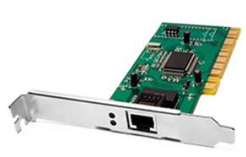
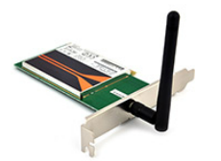
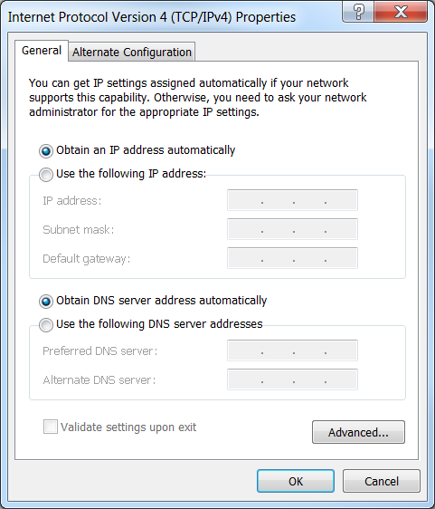
Computer to Network Connection Networking Cards
A wired or wireless network interface card (NIC) is required to connect to the network.
After it is installed, IP settings must be configured either manually or dynamically.
You can also configure advanced settings, such as speed, duplex, Wake on LAN, and quality of service (QoS).
Notes:
8.1 - Computer to Network Connection
8.1.1 - Networking Cards

Slide 15
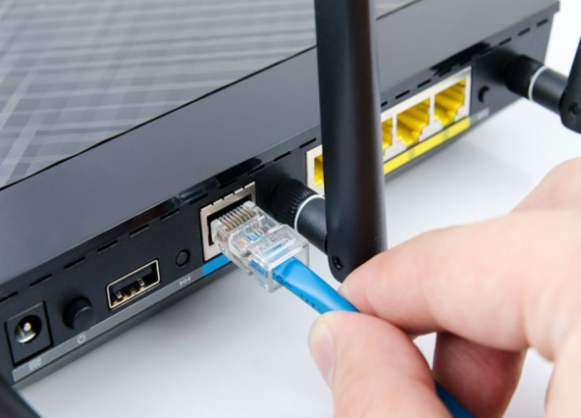
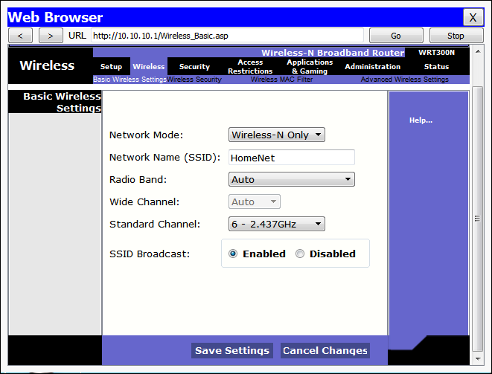
Computer to Network Connection Wireless and Wired Router Configurations
To connect to a network, attach a straight-through Ethernet cable to the NIC port.
The other end connects to a router or to a telecommunications port that is wired so that data will reach the router.
For wireless connections, configure the router with the following:
Network Mode (set the 802.11 standard)
Network Name (SSID)
Channel (important when there are multiple APs in the network)
Wireless Security (should be WPA2)
Notes:
8.1 - Computer to Network Connection
8.1.2 - Wireless and Wired Router Configurations

Slide 16
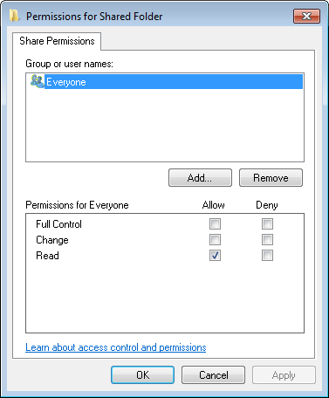
Computer to Network Connection Network Sharing
All Windows computers on a network must be part of either a domain or a workgroup.
Before computers can share resources, they must share the same domain name or workgroup name.
Mapping a local drive is a useful way to access a single file, specific folders, or an entire drive between different operating systems over a network.
Determine which resources will be shared over the network and the type of permissions users will have to the resources.
Read - user can view data in files and run programs
Change - user can add files and subfolders, change the data in files, and delete subfolders and files
Full Control - user can change permissions of files and folders
Notes:
8.1 - Computer to Network Connection
8.1.3 - Network Sharing

Slide 17
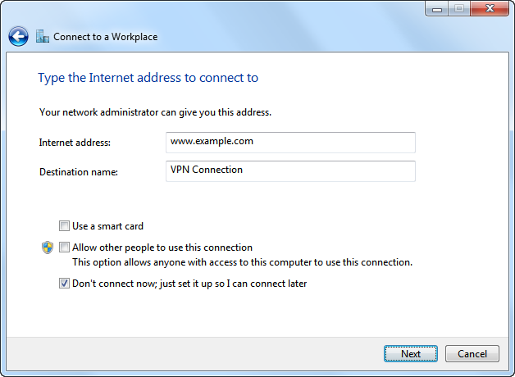
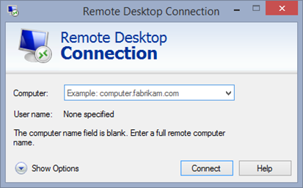
Computer to Network Connection Remote Connections
A virtual private network (VPN) is a private network that connects remote sites or users together over a public network, like the Internet.
When connected to the corporate private network, users become part of that network and have access to all services and resources as if they were physically connected to the corporate LAN.
Remote-access users must install the VPN client on their computers to form a secure connection with the corporate private network.
Remote Desktop allows technicians to view and control a computer from a remote location.
Remote Assistance allows technicians to assist customers with problems from a remote location.
Notes:
8.1 - Computer to Network Connection
8.1.4 - Remote Connections

Slide 18
8.2 ISP Connection Technologies
Notes:
Cisco Networking Academy Program
IT Essentials
Chapter 8: Applied Networking

Slide 19
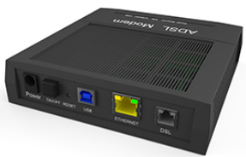
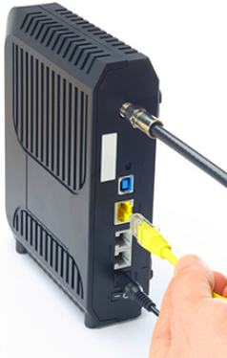
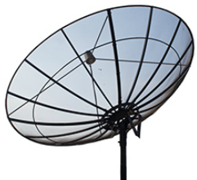
ISP Connection Technologies Broadband Technologies
DSL uses the existing copper telephone lines to provide high-speed digital data communication between end users and telephone companies.
Line of sight wireless Internet is an always-on service that uses radio signals for transmitting Internet access
Cellular technology enables the transfer of voice, video, and data.
Cable uses coaxial cable lines originally designed to carry cable television.
Satellite is an alternative for customers who cannot get cable or DSL connections.
Fiber broadband provides faster connection speeds and bandwidth than cable and DSL.
Notes:
8.2 - ISP Connection Technologies
8.2.1 - Broadband Technologies

Slide 20
8.3 Internet Technologies
Notes:
Cisco Networking Academy Program
IT Essentials
Chapter 8: Applied Networking

Slide 21
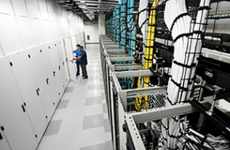
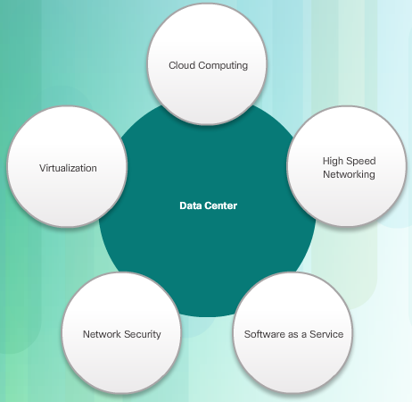
Internet Technologies Data Centers and Cloud Computing
Data center is a data storage and processing facility run by an in-house IT department or leased offsite.
Cloud computing is an off-premise service that offers on-demand access to a shared pool of configurable computing resources.
The three main Cloud services models are:
Software as a Service (SaaS)
Platform as a Service (PaaS)
Infrastructure as a Service (IaaS)
The four Cloud deployment models are:
Private
Public
Community
Hybrid
Notes:
8.3 - Internet Technologies
8.3.1 - Data Centers and Cloud Computing

Slide 22
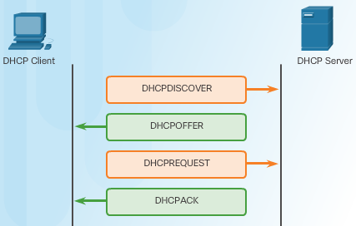
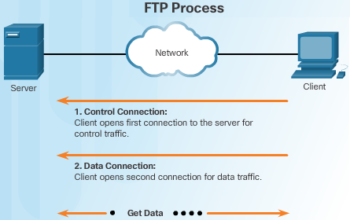
Internet Technologies Networked Host Services
Hosts need a variety of services to securely access resources on the network and the Internet.
Dynamic Host Configuration Protocol (DHCP) dynamically assigns IP addressing information to hosts.
Domain Name Service (DNS) is the method computers use to translate domain names into IP addresses.
Hypertext Transfer Protocol (HTTP) or the secure HTTP (HTTPS) are used by hosts to access web resources
File Transfer Protocol (FTP) allows hosts to transfer data between a client and a server. Secure file transfer options include File Transfer Protocol Secure (FTPS), SSH File Transfer Protocol (SFTP), and Secure Copy (SCP)
Simple Mail Transfer Protocol (SMTP), Post Office Protocol (POP), and Internet Message Access Protocol (IMAP) are the protocols hosts used to send and receive email.
Notes:
8.3 - Internet Technologies
8.3.2 - Networked Host Services

Slide 23
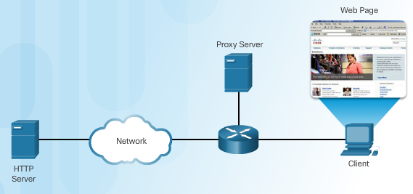
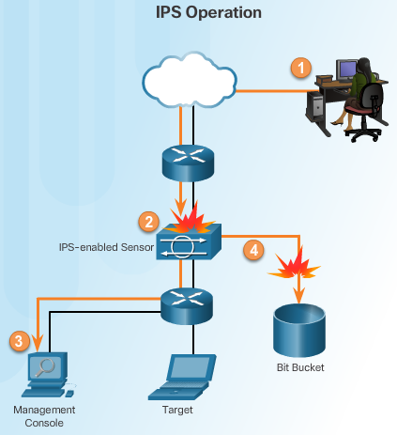
Internet Technologies Networked Host Services (cont.)
Hosts need a variety of services to securely access resources on the network and the Internet.
Print servers enable multiple computer users to access a single printer
Proxy servers are popularly used to act as storage or cache for web pages that are frequently accessed by hosts on the internal network.
AAA is a way to control who is permitted to access a network (authenticate), what they can do while they are there (authorize), and track what actions they perform while accessing the network (accounting).
Intrusion Detection Systems (IDSs) passively monitor traffic on the network while Intrusion Prevention Systems (IPSs) can detect and immediately address a network problem.
Universal Threat Management (UTM) include all the functionality of an IDS/IPS as well as stateful firewall services.
Notes:
8.3 - Internet Technologies
8.3.2 - Networked Host Services

Slide 24
8.4 Common Preventive Maintenance Techniques Used for Networks
Notes:
Cisco Networking Academy Program
IT Essentials
Chapter 8: Applied Networking

Slide 25
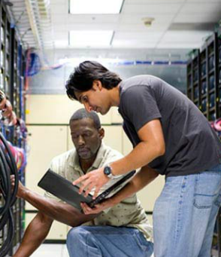
Common Preventive Maintenance Techniques Used for Networks Network Maintenance
Preventive maintenance for networks includes the condition of cables, network devices, servers, and computers to make sure that they are kept clean and are in good working order.
You should develop a plan to perform scheduled maintenance and cleaning at regular intervals.
Inform the network administrator if you notice any of these issues to prevent unnecessary network downtime.
Notes:
8.4 - Common Preventive Maintenance Techniques Used for Networks
8.4.1 - Network Maintenance

Slide 26
8.5 Basic Troubleshooting Process for Networks
Notes:
Cisco Networking Academy Program
IT Essentials
Chapter 8: Applied Networking

Slide 27
Basic Troubleshooting Process for Networks Applying the Troubleshooting Process to Networks
Identify the Problem
The first step in the troubleshooting process.
A list of open and closed-ended questions is useful.
Establish a Theory of Probable Cause
Based on the answers received, establish a theory probable cause.
A list of common problems can be useful.
Test the Theory to Determine Cause
Test your theories to determine the cause of the problem.
A list of quick procedures to common problems can help.
Establish a Plan of Action to Resolve the Problem and Implement the Solution
A plan of action is needed to solve the problem and implement a permanent solution.
Notes:
8.5 – Basic Troubleshooting Process for Networks
8.5.1 - Applying the Troubleshooting Process to Networks

Slide 28
Basic Troubleshooting Process for Networks Applying the Troubleshooting Process to Networks
Verify Full Network Functionality and Implement Preventive Measures
It is important to perform a full network check.
If applicable, implement preventive measures to avoid future problem recurrences.
Document Findings, Actions and Outcomes
Findings, repairs and notes should be documented.
This log can be helpful for future reference.
Notes:
8.5 – Basic Troubleshooting Process for Networks
8.5.1 - Applying the Troubleshooting Process to Networks

Slide 29
Basic Troubleshooting Process for Networks Common Problems and Solutions for Networks
Network problems can be attributed to hardware, software, or configuration issues
Common networking problems include:
Network cables are damaged or unplugged.
Legitimate users are denied remote access.
Device lacks sufficient addressing information.
Users cannot access the Internet.
User cannot map a drive or share a folder on the network.
Notes:
8.5 – Basic Troubleshooting Process for Networks
8.5.2 - Common Problems and Solutions for Networks

Slide 30
8.6 Chapter Summary
Notes:
Cisco Networking Academy Program
IT Essentials
Chapter 8: Applied Networking

Slide 31
Chapter Summary Conclusion
This chapter introduced the operation of computer networks. The following concepts from this chapter are important to remember:
Each device must have appropriate addressing in order to access network resources.
Wired devices are attached to a network using an Ethernet cable. Wireless devices authenticate and associate with a wireless access point.
Mapping a local drive is a useful way to access a single file, specific folders, or an entire drive between different operating systems over a network.
VPNs allow private connections over public networks.
Remote Desktop allows network administrators to remotely control a computer.
Examples of broadband technologies include DSL, cable, and cellular.
Data centers are facilities that provide data storage services.
Cloud computing use data centers to provide cloud services in a variety of deployment models.
Networked host services include DHCP, DNS, HTTP, FTP, SMTP, proxies, AAA, IPSs, and UTMs.
Networks require a systematic preventive maintenance and troubleshooting methodology.
Notes:
8.6 – Chapter Summary
8.6.1 - Conclusion

Slide 33


Slide 34
Chapter 8 New Terms and Commands
aaa
adsl
broadband
broadcast
cellular
ddos
dhcp
dhcpdiscover
dhcpoffer
dish (antenna)
dns
downlink
dsl
duplex
ftps
gateway
gprs
gsm
hsdpa
html
http
https
hypertext
idss
imap
ipconfig
ips
ipv4
ipv6
isdn
isp
linksys
microwave
mimo
nat
netbios
netgear
nslookup
ntfs
Notes:
New Terms and Commands

Slide 35
Chapter 8 New Terms and Commands (Cont.)
phishing
qos
saas
scp
sftp
sms
smtp
ssh
ssid
ssl
stateful
tcp
tls
tracert
trendnet
utm
utms
vpn
wimax
wol
Notes:
New Terms and Commands (Cont.)

